Slide 1
Sequential Pattern Mining

Slide 2
Outline
What is sequence database and sequential pattern mining
Methods for sequential pattern mining
Constraint-based sequential pattern mining
Periodicity analysis for sequence data

Slide 3
Sequence Databases
A sequence database consists of ordered elements or events
Transaction databases vs. sequence databases
A transaction database
A sequence database
TID | itemsets
10 | a, b, d
20 | a, c, d
30 | a, d, e
40 | b, e, f
SID | sequences
10 | <a(abc)(ac)d(cf)>
20 | <(ad)c(bc)(ae)>
30 | <(ef)(ab)(df)cb>
40 | <eg(af)cbc>

Slide 4
Applications
Applications of sequential pattern mining
  Customer shopping sequences:
    First buy computer, then CD-ROM, and then digital camera, within 3 months.
  Medical treatments, natural disasters (e.g., earthquakes), science & eng. processes, stocks and markets, etc.
  Telephone calling patterns, Weblog click streams
  DNA sequences and gene structures

Slide 5
Subsequence vs. super sequence
A sequence is an ordered list of events, denoted < e₁ e₂ … e_{l} >
Given two sequences α=< a₁ a₂ … a_{n} > and β=< b₁ b₂ … b_{m} >
α is called a subsequence of β, denoted as α⊆ β, if there exist integers 1≤ j₁ < j₂ <…< j_{n} ≤m such that a₁ ⊆ b_{j1}, a₂ ⊆ b_{j2},…, a_{n} ⊆ b_{jn}
β is a super sequence of α
  E.g.α=< (ab), d> and β=< (abc), (de)>

Slide 6
What Is Sequential Pattern Mining?
Given a set of sequences and support threshold, find the complete set of frequent subsequences
A sequence : < (ef) (ab) (df) c b >
A sequence database
SID | sequence
10 | <a(abc)(ac)d(cf)>
20 | <(ad)c(bc)(ae)>
30 | <(ef)(ab)(df)cb>
40 | <eg(af)cbc>
An element may contain a set of items.
Items within an element are unordered
and we list them alphabetically.
<a(bc)dc> is a subsequence of <a(abc)(ac)d(cf)>
Given support threshold min_sup =2, <(ab)c> is a sequential pattern

Slide 7
Challenges on Sequential Pattern Mining
A huge number of possible sequential patterns are hidden in databases
A mining algorithm should
  find the complete set of patterns, when possible, satisfying the minimum support (frequency) threshold
  be highly efficient, scalable, involving only a small number of database scans
  be able to incorporate various kinds of user-specific constraints

Slide 8
Studies on Sequential Pattern Mining
Concept introduction and an initial Apriori-like algorithm
  Agrawal & Srikant. Mining sequential patterns, [ICDE’95]
Apriori-based method: GSP (Generalized Sequential Patterns: Srikant & Agrawal [EDBT’96])
Pattern-growth methods: FreeSpan & PrefixSpan (Han et al.KDD’00; Pei, et al. [ICDE’01])
Vertical format-based mining: SPADE (Zaki [Machine Leanining’00])
Constraint-based sequential pattern mining (SPIRIT: Garofalakis, Rastogi, Shim [VLDB’99]; Pei, Han, Wang [CIKM’02])
Mining closed sequential patterns: CloSpan (Yan, Han & Afshar [SDM’03])

Slide 9
Methods for sequential pattern mining
Apriori-based Approaches
  GSP
  SPADE
Pattern-Growth-based Approaches
  FreeSpan
  PrefixSpan

Slide 10
The Apriori Property of Sequential Patterns
A basic property: Apriori (Agrawal & Sirkant’94)
  If a sequence S is not frequent, then none of the super-sequences of S is frequent
  E.g, <hb> is infrequent so do <hab> and <(ah)b>
Seq. ID
Sequence
10
<(bd)cb(ac)>
Given support threshold min_sup =2
20
<(bf)(ce)b(fg)>
30
<(ah)(bf)abf>
40
<(be)(ce)d>
50
<a(bd)bcb(ade)>

Slide 11
GSP—Generalized Sequential Pattern Mining
GSP (Generalized Sequential Pattern) mining algorithm
Outline of the method
  Initially, every item in DB is a candidate of length-1
  for each level (i.e., sequences of length-k) do
    scan database to collect support count for each candidate sequence
    generate candidate length-(k+1) sequences from length-k frequent sequences using Apriori
  repeat until no frequent sequence or no candidate can be found
Major strength: Candidate pruning by Apriori

Slide 12
Finding Length-1 Sequential Patterns
Initial candidates:
  <a>, <b>, <c>, <d>, <e>, <f>, <g>, <h>
Scan database once, count support for candidates
Cand | Sup
<a> | 3
<b> | 5
<c> | 4
<d> | 3
<e> | 3
<f> | 2
<g> | 1
<h> | 1
min_sup =2
Seq. ID
Sequence
10
<(bd)cb(ac)>
20
<(bf)(ce)b(fg)>
30
<(ah)(bf)abf>
40
<(be)(ce)d>
50
<a(bd)bcb(ade)>

Slide 13
Generating Length-2 Candidates
 | <a> | <b> | <c> | <d> | <e> | <f>
<a> | <aa> | <ab> | <ac> | <ad> | <ae> | <af>
<b> | <ba> | <bb> | <bc> | <bd> | <be> | <bf>
<c> | <ca> | <cb> | <cc> | <cd> | <ce> | <cf>
<d> | <da> | <db> | <dc> | <dd> | <de> | <df>
<e> | <ea> | <eb> | <ec> | <ed> | <ee> | <ef>
<f> | <fa> | <fb> | <fc> | <fd> | <fe> | <ff>
51 length-2
Candidates
 | <a> | <b> | <c> | <d> | <e> | <f>
<a> |  | <(ab)> | <(ac)> | <(ad)> | <(ae)> | <(af)>
<b> |  |  | <(bc)> | <(bd)> | <(be)> | <(bf)>
<c> |  |  |  | <(cd)> | <(ce)> | <(cf)>
<d> |  |  |  |  | <(de)> | <(df)>
<e> |  |  |  |  |  | <(ef)>
<f>
Without Apriori property,
8*8+8*7/2=92 candidates
Apriori prunes
44.57% candidates

Slide 14
Finding Lenth-2 Sequential Patterns
Scan database one more time, collect support count for each length-2 candidate
There are 19 length-2 candidates which pass the minimum support threshold
  They are length-2 sequential patterns

Slide 15
The GSP Mining Process
5th scan: 1 cand. 1 length-5 seq. pat.
<(bd)cba>
Cand. cannot pass sup. threshold
4th scan: 8 cand. 6 length-4 seq. pat.
<abba> <(bd)bc> …
Cand. not in DB at all
3rd scan: 46 cand. 19 length-3 seq. pat. 20 cand. not in DB at all
<abb> <aab> <aba> <baa> <bab> …
2nd scan: 51 cand. 19 length-2 seq. pat. 10 cand. not in DB at all
<aa> <ab> … <af> <ba> <bb> … <ff> <(ab)> … <(ef)>
1st scan: 8 cand. 6 length-1 seq. pat.
<a> <b> <c> <d> <e> <f> <g> <h>
Seq. ID
Sequence
min_sup =2
10
<(bd)cb(ac)>
20
<(bf)(ce)b(fg)>
30
<(ah)(bf)abf>
40
<(be)(ce)d>
50
<a(bd)bcb(ade)>

Slide 16
The GSP Algorithm
Take sequences in form of <x> as length-1 candidates
Scan database once, find F₁, the set of length-1 sequential patterns
Let k=1; while F_{k} is not empty do
  Form C_{k+1}, the set of length-(k+1) candidates from F_{k};
  If C_{k+1} is not empty, scan database once, find F_{k+1}, the set of length-(k+1) sequential patterns
  Let k=k+1;

Slide 17
The GSP Algorithm
Benefits from the Apriori pruning
  Reduces search space
Bottlenecks
  Scans the database multiple times
  Generates a huge set of candidate sequences
There is a need for more efficient mining methods

Slide 18
Mining Time-Series Data
Time-series database
  Consists of sequences of values or events changing with time
  Data is recorded at regular intervals
  Characteristic time-series components
    Trend, cycle, seasonal, irregular
Applications
  Financial: stock price, inflation
  Industry: power consumption
  Scientific: experiment results
  Meteorological: precipitation

Slide 19
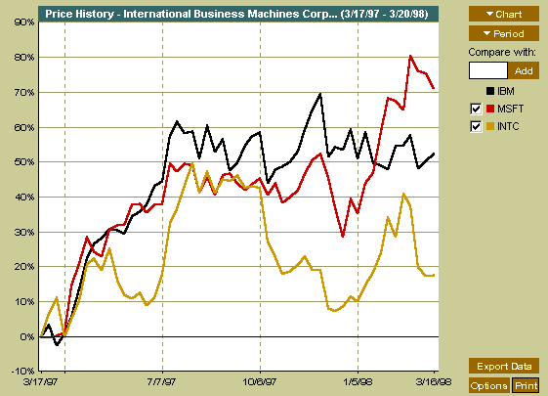
A time series can be illustrated as a time-series graph which describes a point moving with the passage of time

Slide 20
Categories of Time-Series Movements
Categories of Time-Series Movements
  Long-term or trend movements (trend curve): general direction in which a time series is moving over a long interval of time
  Cyclic movements or cycle variations: long term oscillations about a trend line or curve
    e.g., business cycles, may or may not be periodic
  Seasonal movements or seasonal variations
    i.e, almost identical patterns that a time series appears to follow during corresponding months of successive years.
  Irregular or random movements

Slide 21
Multimedia Data Mining
Data Mining: Principles and Algorithms

Slide 22
Multimedia Data Mining
Multimedia data types
  any type of information medium that can be represented, processed, stored and transmitted over network in digital form
  Multi-lingual text, numeric, images, video, audio, graphical, temporal, relational, and categorical data.
  Relation with conventional data mining term
Data Mining: Principles and Algorithms

Slide 23
Definitions
Subfield of data mining that deals with an extraction of implicit knowledge, multimedia data relationships, or other patterns not explicitly stored in multimedia databases
  Influence on related interdisciplinary fields
  Databases – extension of the KDD (rule patterns)
  Information systems – multimedia information analysis and retrieval – content-based image and video search and efficient storage organization
Data Mining: Principles and Algorithms

Slide 24
Information model
Data segmentation
  Multimedia data are divided into logical interconnected segments (objects)
  Pattern extraction
  Mining and analysis procedures should reveal some relations between objects on the different level
  Knowledge representation
  Incorporated linked patterns
Data Mining: Principles and Algorithms

Slide 25
Multimedia Data
Image data:
  Extracted by aggregation and/or approximation
  Size, color, shape, texture, orientation, and relative positions and structures of the contained objects or regions in the image
Music data:
  Summarize its melody: based on the approximate patterns that repeatedly occur in the segment
  Summarized its style: based on its tone, tempo, or the major musical instruments played
Data Mining: Principles and Algorithms

Slide 26
Multidimensional Analysis of Multimedia Data
Multimedia data cube
  Design and construction similar to that of traditional data cubes from relational data
  Contain additional dimensions and measures for multimedia information, such as color, texture, and shape
The database does not store images but their descriptors
  Feature descriptor: a set of vectors for each visual characteristic
    Color vector: contains the color histogram
    MFC (Most Frequent Color) vector: five color centroids
    MFO (Most Frequent Orientation) vector: five edge orientation centroids
  Layout descriptor: contains a color layout vector and an edge layout vector
Data Mining: Principles and Algorithms

Slide 27
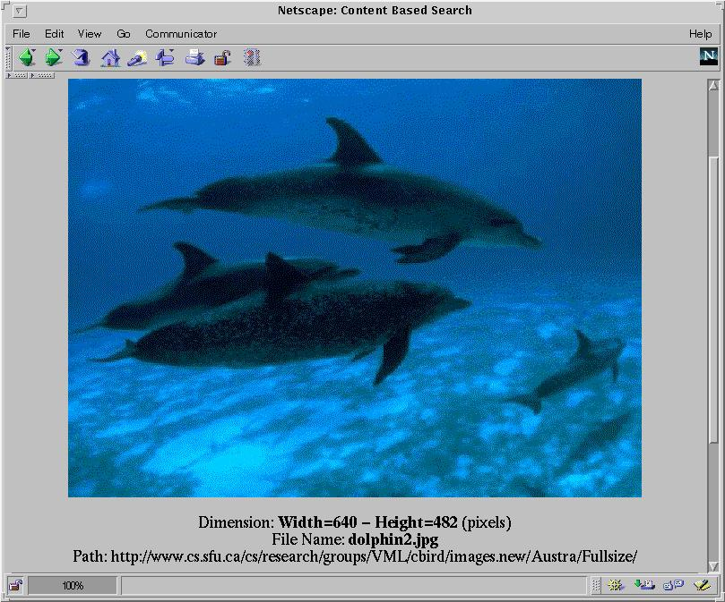
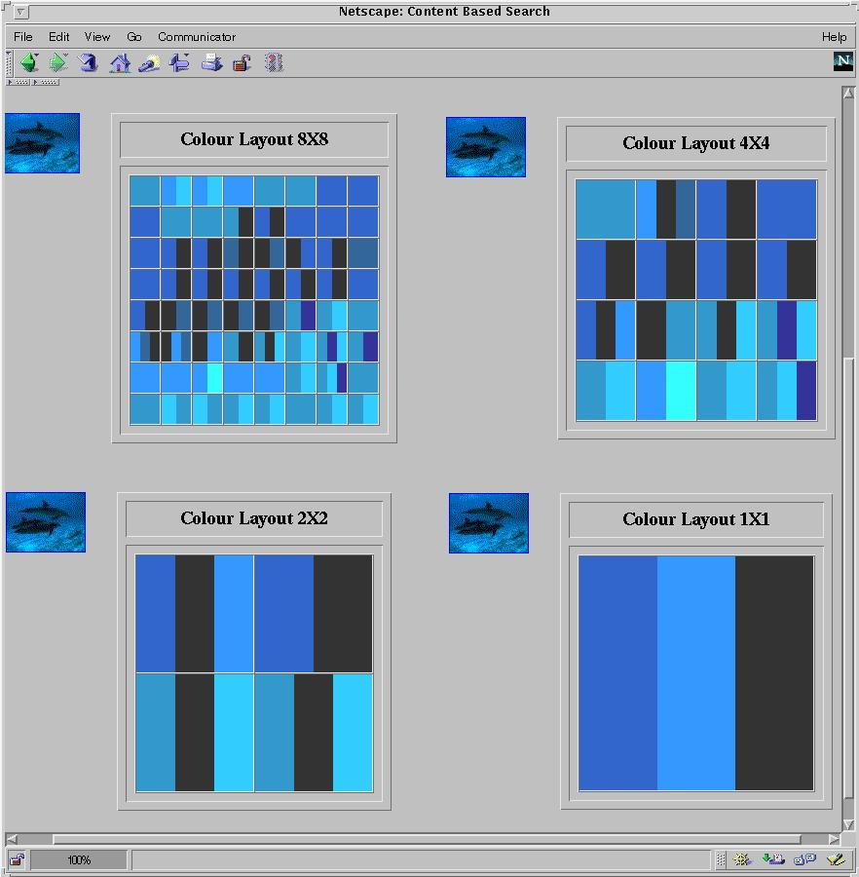
Multi-Dimensional Search in Multimedia Databases
Data Mining: Principles and Algorithms

Slide 28
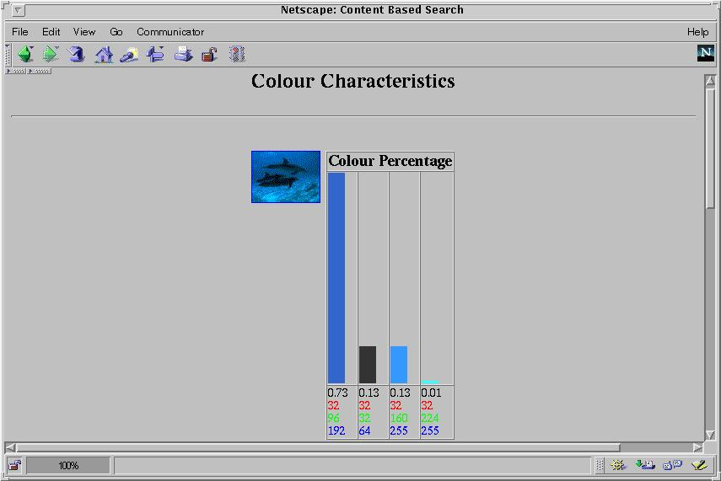
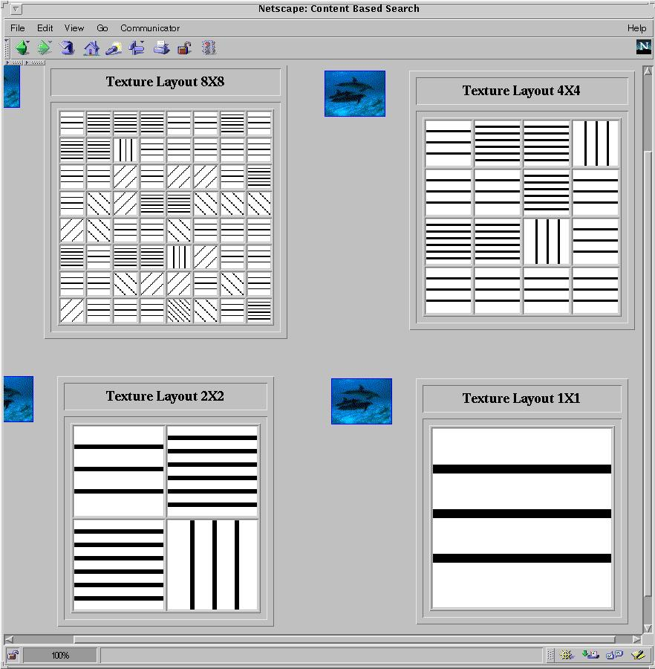
Multi-Dimensional Analysis in Multimedia Databases
Color histogram
Texture layout
Data Mining: Principles and Algorithms

Slide 29



Mining Multimedia Databases
Refining or combining searches
Search for “airplane in blue sky”
(top layout grid is blue and
keyword = “airplane”)
Search for “blue sky and
green meadows”
(top layout grid is blue
and bottom is green)
Search for “blue sky”
(top layout grid is blue)
Data Mining: Principles and Algorithms

Slide 30

Mining Multimedia Databases
Three Dimensions
The Data Cube and
the Sub-Space Measurements
JPEG
GIF
Small
Medium
Large
Very Large
Two Dimensions
By Size
By Format
By Format & Size
RED
WHITE
Cross Tab
BLUE
By Colour
By Colour & Size
By Format & Colour
JPEG
GIF
RED
Sum
By Colour
WHITE
BLUE
Format of image
Duration
Colors
Textures
Keywords
Size
Width
Height
Internet domain of image
Internet domain of parent pages
Image popularity
Group By
By Format
Colour
Sum
RED
WHITE
BLUE
Dimensions
Measurement
Sum
Data Mining: Principles and Algorithms

Slide 31

Mining Multimedia Databases in
MultiMediaMiner
Data Mining: Principles and Algorithms

Slide 32
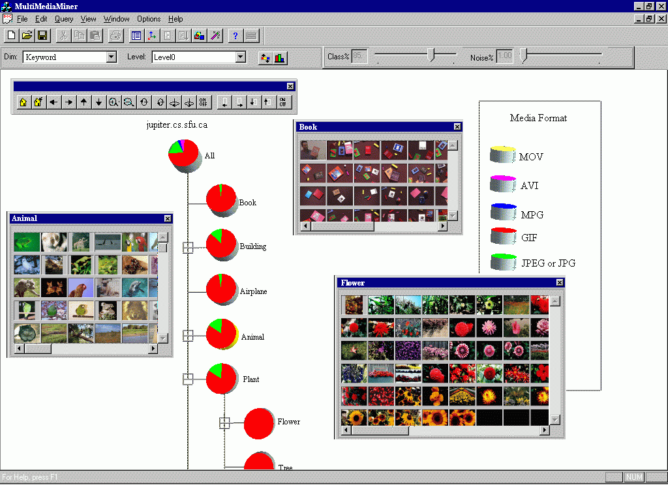
Classification in MultiMediaMiner
Data Mining: Principles and Algorithms

Slide 33
Mining Associations in Multimedia Data
Associations between image content and non-image content features
  “If at least 50% of the upper part of the picture is blue, then it is likely to represent sky.”
  “If a picture contains two blue squares, then it is likely to contain one red circle as well.”
  “If a red triangle is between two yellow squares, then it is likely a big oval-shaped object is underneath.”
Data Mining: Principles and Algorithms

